Slide 1
Reducing Heliostat Field Costs
by Direct Measurement of the Mirror Orientation

Slide 2
Introduction
G.Rosinga (Sun2Point)
E. Du Marchie van Voorthuysen (SOLAQ B.V.)
P. C. van den Donker (Sun2Point)
(MSc) Delft University (Electronics)
Factory automation & product design - Philips Electronics
Quality management - Bosch Security Systems
(Yearly production > 1,000,000 pcs.)
© www.Sun2Point.com

Slide 3

Reducing Heliostat Field Costs
by Mass Manufacturing
Presentation for SolarPACES 2015 Conference
October 13-16, Cape Town, South Africa
Thursday 15/10/15 , 16:35, Room 2.60, Sun2Point
© www.Sun2Point.com

Slide 4
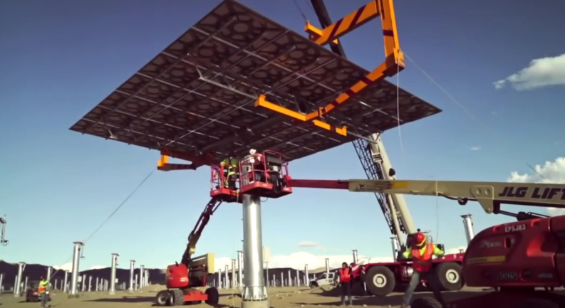
Huge Heliostats ?
© www.Sun2Point.com

Slide 5



or Small Heliostats ?
© www.Sun2Point.com

Slide 6
Heliostat Sizes in Projects
Initial sizes (m²) | Successor sizes (m²)
120 | 140
15.6 | 20
1.1 | 2.2
Critical size boundaries:
Weight: related to manual installation
Inner sea container dimensions 2.35 x 2.39m
Lifting equipment and/or a factory on the terrain adds to the costs
© www.Sun2Point.com

Slide 7
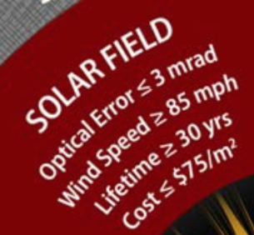
Sunshot Program Targets
The LCOE for the solar field has to decrease
9 cnts / kWh (2010) 2 cnts / kWh.
© www.Sun2Point.com

Slide 8

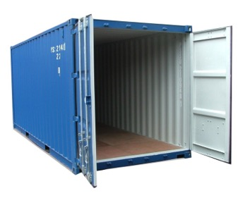


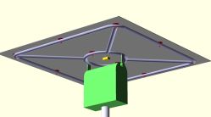
Possible Solution (or Revolution?)
Mass manufacturing small heliostats off site
vs Manufacturing large heliostats on site
Two men can place small heliostats by hand
Mass manufacturing leads to efficiency and lower prices.
Fast learning by high quantities leads to increased reliability
© www.Sun2Point.com

Slide 9
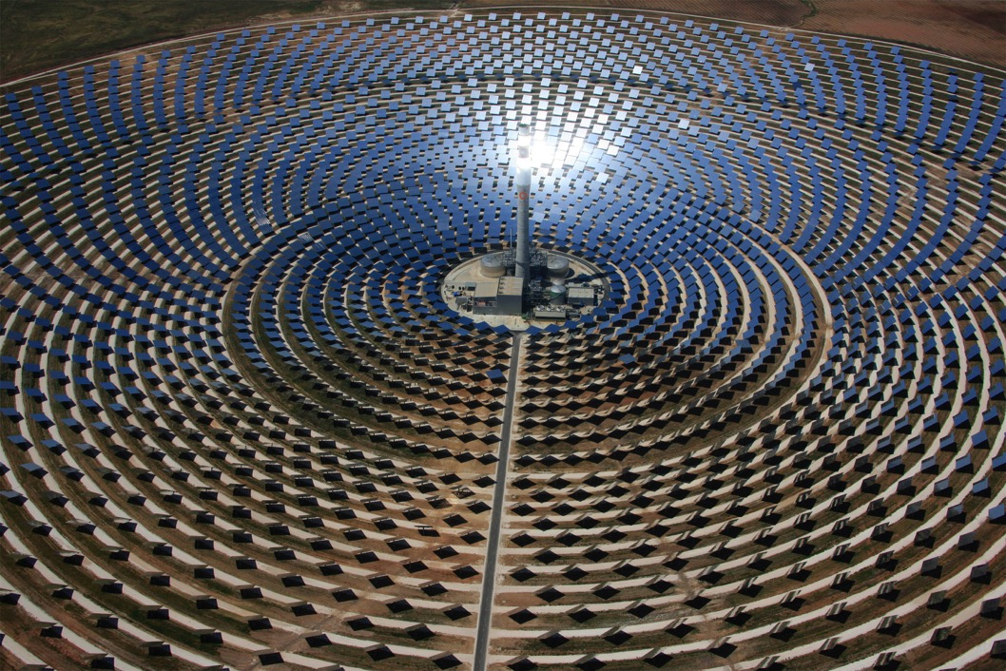
Small Quantities vs Mass Manufacturing
120 m2
8,000 heliostats
2.25 m2
432,000 heliostats
1:54

Slide 10
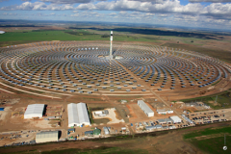
Present Practice (1)
120 m2 Heliostats
Mirror modules are mounted on a frame in a temporary assembly plant
8 men involved during placement
Heavy lifting equipment required
© www.Sun2Point.com

Slide 11
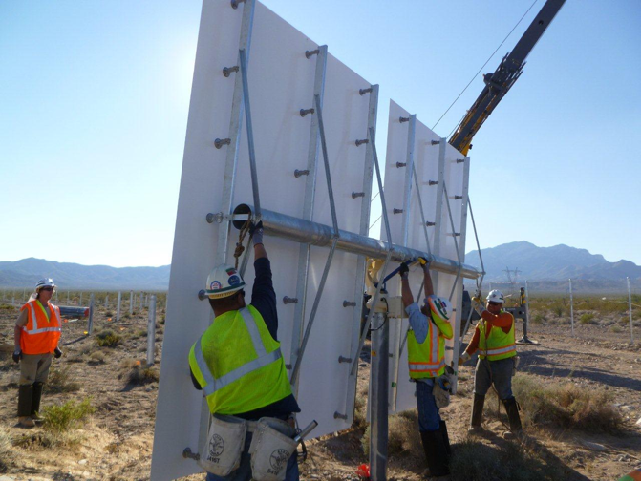
Present Practice (2)
15.6 m2 Heliostats
5 men involved during placement
Some heavy lifting equipment required
© www.Sun2Point.com

Slide 12
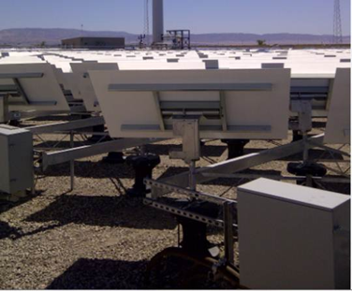
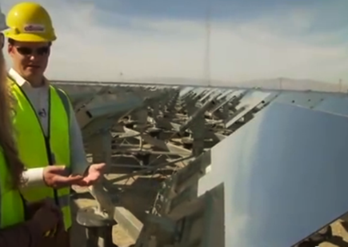
Present Practice (3)
1.1 m2 Heliostats
© www.Sun2Point.com

Slide 13
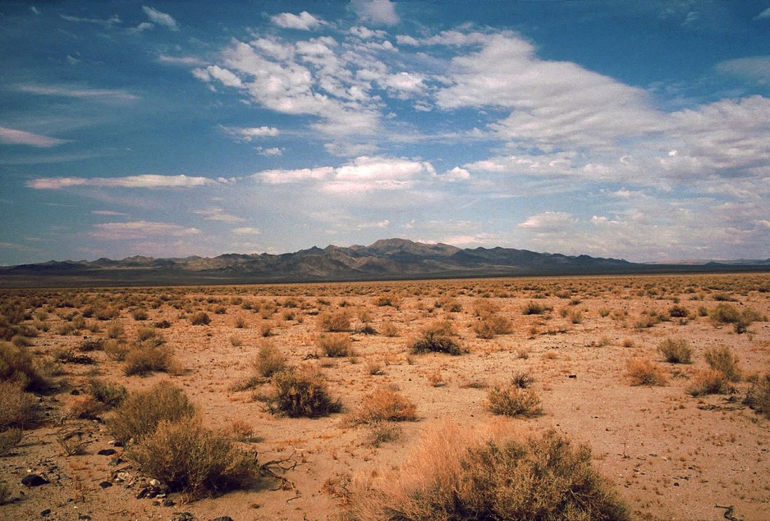
Mass Manufacturing Off Site
Mass manufacturing leads to efficiency and lower prices.
Fast learning with high quantities leads to increased reliability
Two men can place small heliostats by hand
© www.Sun2Point.com

Slide 14

Major Mass Heliostat Properties
Can be hand carried for installation
    < 40 kg.
No cabling required
Remotely controlled by wireless communication
Self powered by solar cells.
Autonomous
Has buit-in ‘intelligence’
Requires minimal communication with the control centre
Simple foundation and fixation
  Compensates orientation changes or deviations of the support
Factory calibrated
Start up by providing the GPS information (time and location)
and the target direction.
© www.Sun2Point.com

Slide 15
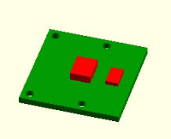
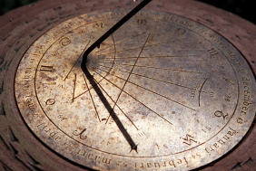
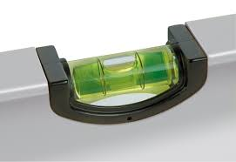
Direct Mirror Measurement
Locating the sun
Locating the horizon
The developed control box measures orientation towards earth,
independent of sagging, bending or torsion
No adjustment required
© www.Sun2Point.com

Slide 16
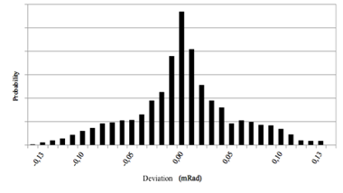
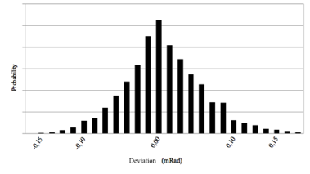
Prototype Accuracy
-0.15
-0.10
-0.05
0.00
0.05
0.10
0.15
-0.15
-0.10
0.00
0.10
0.15
Deviation (mRad)
Deviation (mRad)
Optical measurement related error
Acceleration measurement related error
© www.Sun2Point.com

Slide 17

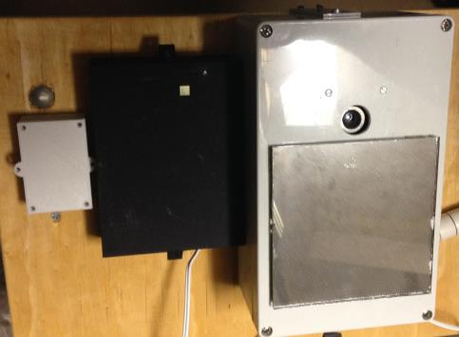
Prototype Size
© www.Sun2Point.com

Slide 18
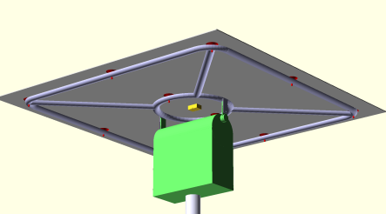
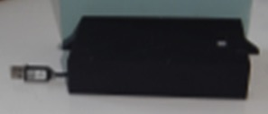
Orientation Error Budget
The control box
Error budget
Measurement error
Drive error
Support error
Steady windload component
Ground settling
© www.Sun2Point.com
Notes:
A measuemernt idea came to our mind:
What if we can measure directly towards the earth
That would circumvent a number of error sources.
Coudl this be realized ?
Based on the gravity acceleration and optical observation of the sun ?
The answer was “yes we can!”

Slide 19

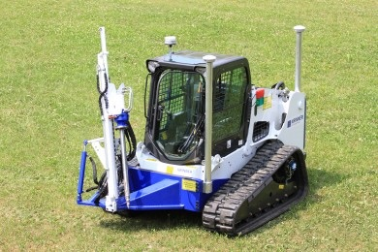
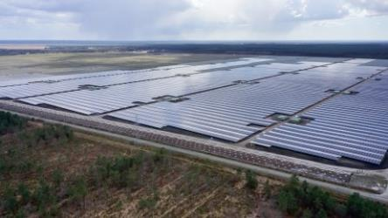
Automatic Foundation Placement
200,000
of these foundation
screw-poles
can be placed
in 10 months
© www.Sun2Point.com

Slide 20
Reduced On Site Work
Calibration work
Ground work
Cabling work
Factory calibrated measurement and control box
Wireless control
Solar cell powered
Breaks down the barriers on the path to small heliostats
© www.Sun2Point.com

Slide 21

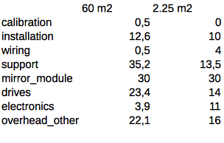
Costs / m²
60 m² ⁻ 128 euro
2.25 m² ⁻ 98 euro
Calibration 0.5
Installation 12.6
Wiring 0.5
No calibration !
Support 35.2
Installation 10
Wiring 4
Support 13.5
Mirror module
30
Mirror module
30
Drives 23.4
Drives 14
Electronics 3.9
Electronics 11
Overhead/Other
22.1
Overhead/Other
16
© www.Sun2Point.com

Slide 22
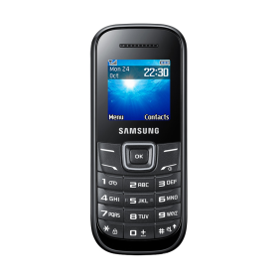
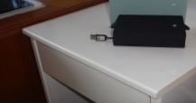
Costs of Electronics
The control box
Keyboard
Display
Microphone
Loudspeaker
Buzzer
© www.Sun2Point.com

Slide 23
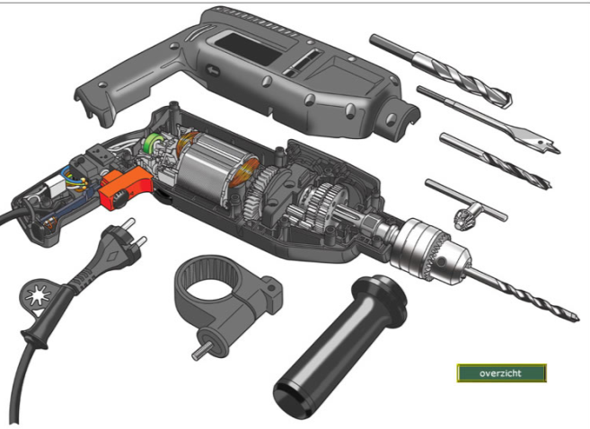
Low Priced Gears
No ‘Rocket Science’
Can be manufactured cheap
© www.Sun2Point.com

Slide 24


Conclusions
Mass manufacturing will greatly reduce the costs of the heliostats
Additional measures will make the use of mass manufactured heliostats possible
Key to the above is our new DIRECT measurement method / Control box
Sun2Point has expertise in electronics
and mass manufacturing
© www.Sun2Point.com

